Slide 1


Titolo presentazione sottotitolo
SafeStreets: Presentation
Morreale Federico 945258 Maddes Evandro 945642
Innocente Federico 870726
Milano, XX mese 20XX
Professor: Matteo Giovanni Rossi

Slide 2
GOALS
1) Upload a report
2) View last reports on map
3) Query the system
4) Give a feedback

Slide 3
GOALS
6) Identify potentially unsafe areas
7) Suggest possible interventions
8) Build statistics
5) Show/hide sensitive information

Slide 4
OVERVIEW
The users registered as Citizens will be allowed to:
Register and login;
Upload violations;
See all the violations uploaded by other users without sensitive information;
Check unsafe areas;
See statistics about violations;
Send feedback on inappropriate pictures or reports;

Slide 5
OVERVIEW
The users registered as authority will be allowed to:
Perform all the actions allowed to a citizen;
See all the sensitive information;
Mark the fined violation;
See the worst offenders;
The interaction between SafeStreets and municipalities will allow Safestreets to:
Get information on the accidents occurred in the territory;
Provide possible interventions;

Slide 6
DOMAIN ASSUMPTIONS & CONSTRAINTS
Assumptions:
Original license plates
Accurate GPS
Accurate municipality accidents
Constraints:
Device provided with camera and GPS
Dependencies:
Only violation with a visible plate can be fined

Slide 7
PHENOMENA
Phenomena | Shared | Controlled by
Users recognize the type of violation that occurred | N | W
People commit violations | N | W
People perform accidents | N | W
Police emits traffic tickets | N | W
Machine manages database queries | N | M
Machine stores information (users and pictures with data) on the database | N | M
Machine manages interfaces with external software | N | M
Users have to take and upload the pictures of the violations | Y | W
Users query the system to get violations | Y | W
The machine gets the information about the accidents from the local municipality | Y | M
Machine crosses information about accidents and violations to submit possible interventions, that can be both considered or not | Y | M
The municipality can mark reported violations as 􏰀fined, to allow the system to perform statistics about the effectiveness of SafeStreets. | Y | W
Y: Yes N:No W:worl d M: Machine

Slide 8
REQUIREMENTS
Users can view the reports on the map
Only authorities can see sensitive information
Reports must contain the violation type and at least one picture
Users can provide feedback to the violations
Authority can mark violations as fined

Slide 9
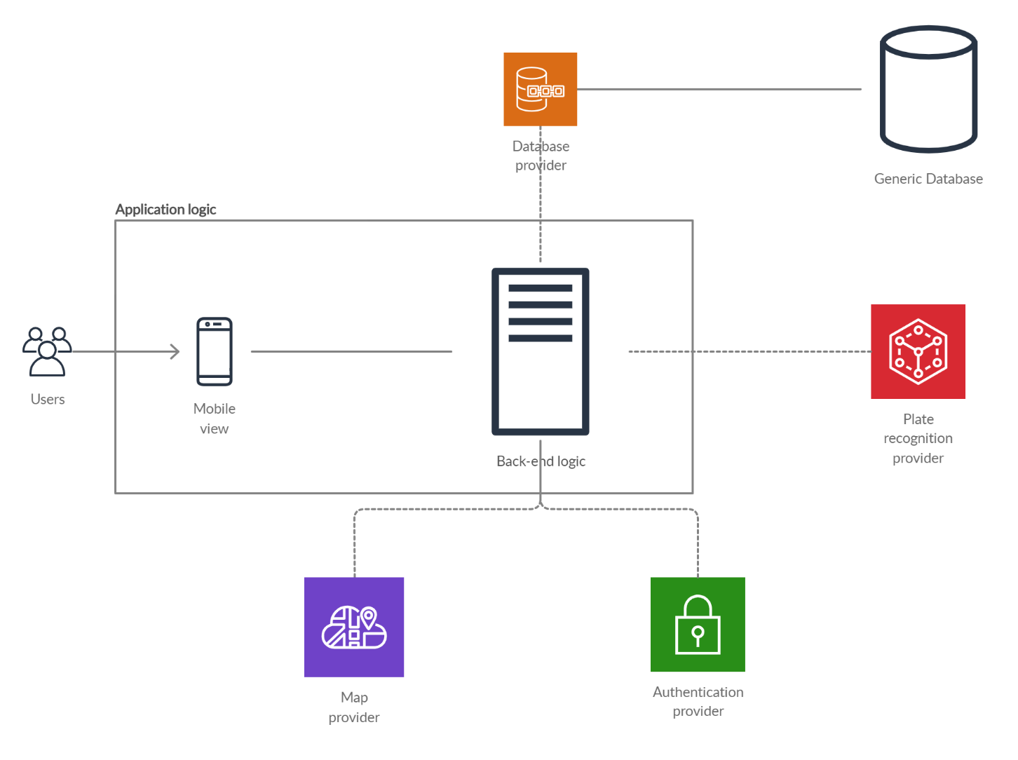
COMPONENT OVERVIEW

Slide 10
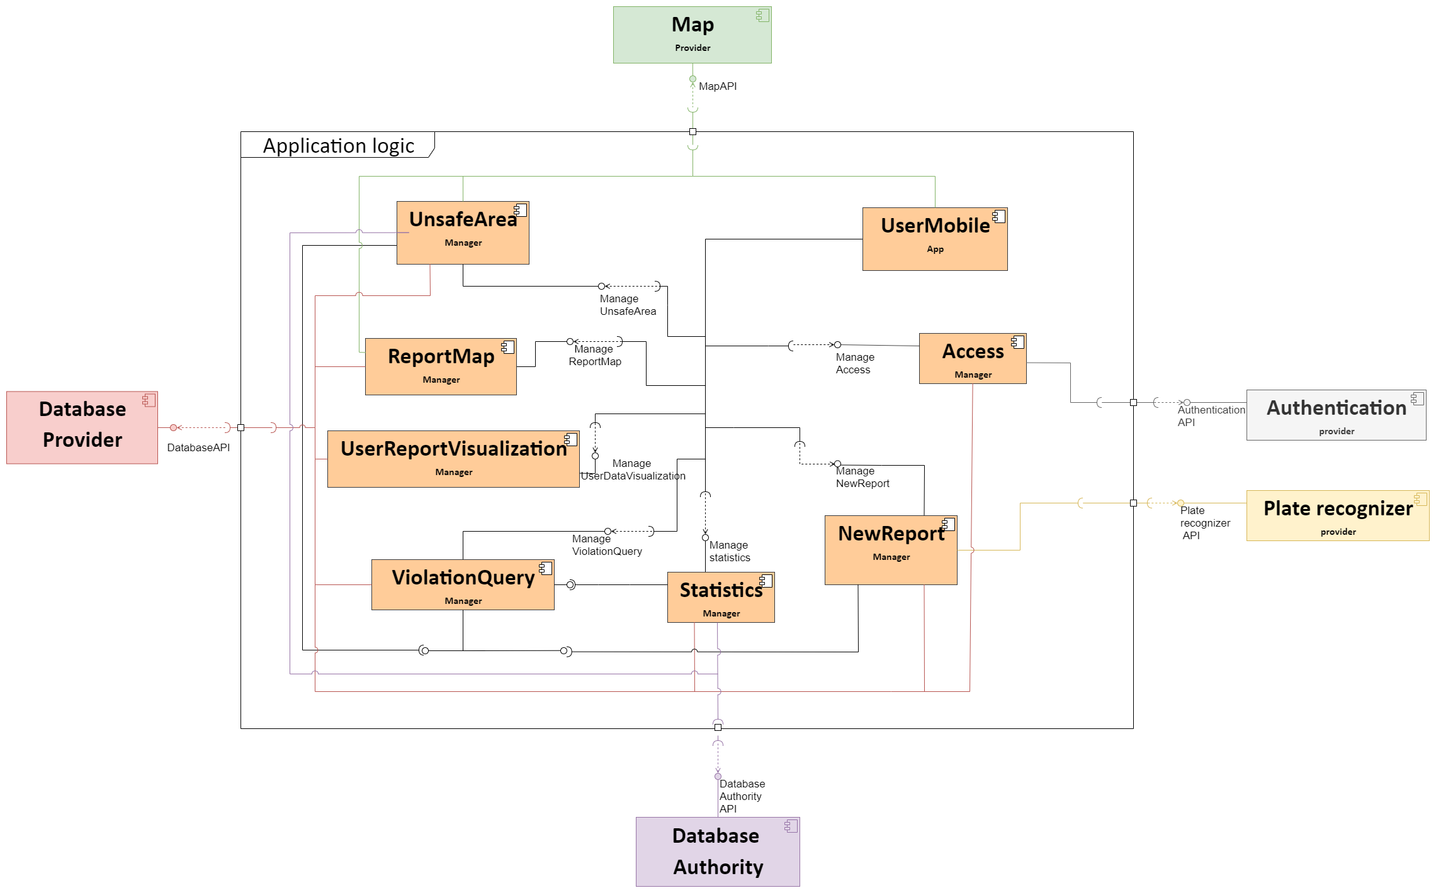
COMPONENT DIAGRAM

Slide 11
TRACEABILITY MATRIX
REQUIREMENTS | MANAGER | PROVIDER
Users can view the reports in the map | ReportMap manager ViolationQuery manager | Map provider
Authorities can see all the sensitive information contained in a report while Citizens cannot | UserReportVisualization manager
A report must contain at least one image and indicate the type of violation | NewReport manager
A user can select negative feedback for each report | UserReportVisualization manager
Authorities can mark a report as “fined” | UserReportVisualization manager

Slide 12
ARCHITECTURAL STYLE AND PATTERNS
Three-tier architecture
Serverless Approach
MVVM (Model-View-ViewModel)
RESTful architecture

Slide 13
PROVIDER CHOICE
PROVIDER FOR | WHAT WE WANT | WHAT WE CHOOSE
Authentication | Register new users Authenticate the registered one | Firebase Auth
Map | Display the position of the user Show reports on the map. | Google Maps
Plate recognizer | From a photo to readable file | Plate Recognizer
Database | Stores reports with metadata Retrieve information by the user email | Firebase Storage with Cloud Firestore

Slide 14
IMPLEMENTATION & TEST PLAN
HIGH
Violation reporting
Daily map visualization
Violation visualization
Show/hide sensitive information
Give a feedback to a violation
MEDIUM
Sign up & login
Query all the violaitons
Build statistics on the violations
Mark dangerous areas
Mark violation as fined
LOW
Visualization of customer’s own reports
Provide suggestions about unsafe areas

Slide 15
WHAT WE IMPLEMENTED
Register and Login as Citizen or Authority
Reports displayed on the map
Statistics for both Citizens and Authorities
Search for reports given some parameters
Sensitive information hidden for Citizens
My reports section
Create report
Delete report
Feedback a report

Slide 16
DEMO
What’s in the demo:
Registration + Login
Create a report
Search for a report
Look inside “my reports”
Fine a report
Statistics
Logout

Slide 17
DEMO
It’s demo time!

Slide 18
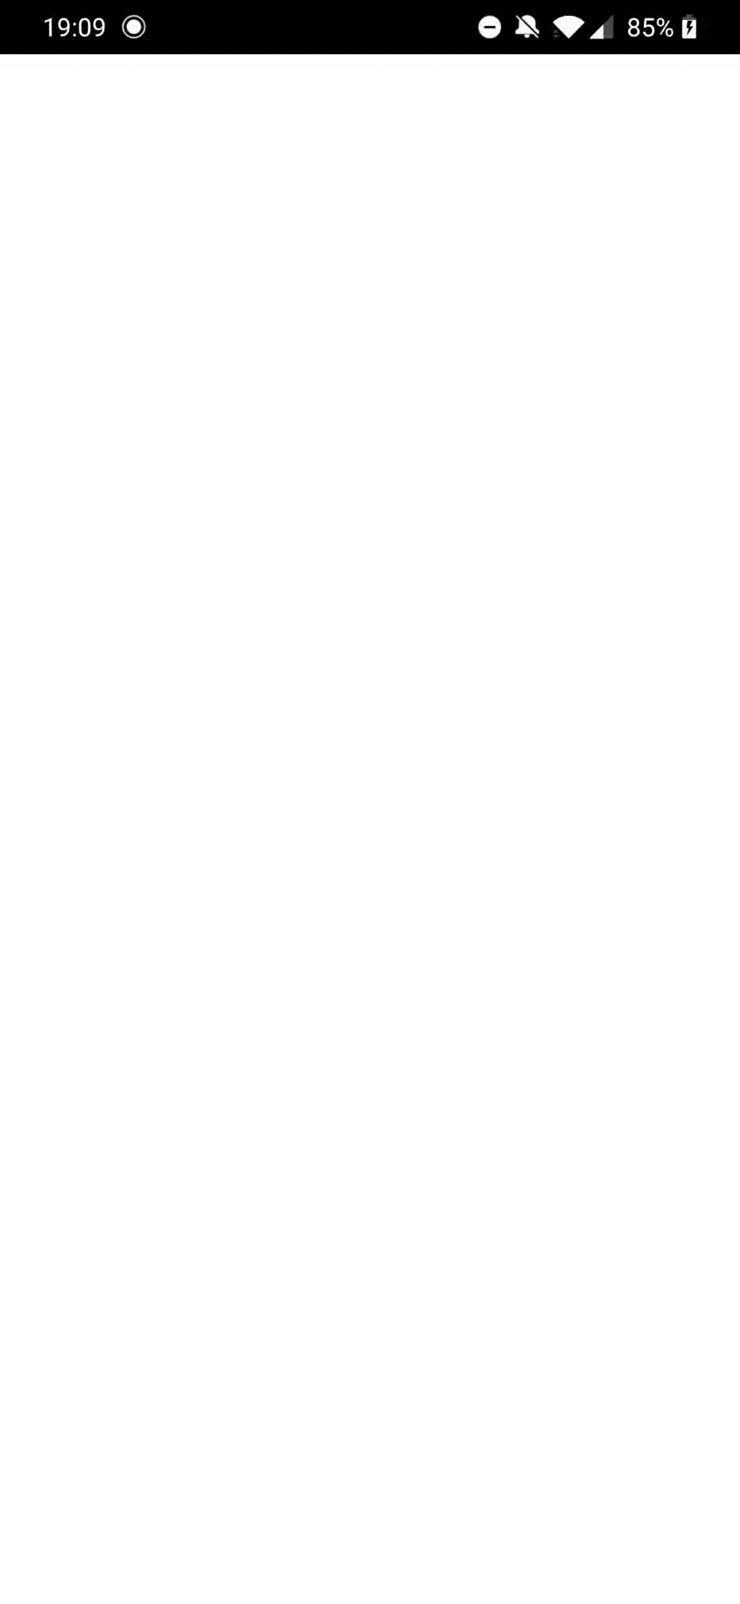

Slide 19
ADOPTED FRAMEWORK & SERVICES
Front-end:
Flutter
Mockito
Back-end:
Firebase

Slide 20
RELATION WITH DD
In the code we implemented the managers as described in the DD:
AccessManager
StatsManager
ViolationQueryManager
NewReportManager
UserReportVisualizationManager
ReportMapManager

Slide 21
TESTING
3 type of tests:
Unit:
To test managers
Widget:
How they behave
Integration:
Self-driven test (automatic)

Slide 22
Cosa ci deve essere
For the RASD part:
Goals of the system
Boundaries, for example describe some world and machine phenomena to highlight such boundaries
Meaningful use cases
The most important three to five requirements
The most important assumptions
What you aim to analyse and prove through the Alloy model
For the DD part:
The components of your system
Their interfaces
Meaningful interactions
The architectural styles/patterns and important design decisions
The strategy you plan to use to carry the implementation, integration and testing of your system and how this is strategy mapped on your components
For the ITD part, we do expect teams to provide a short demo of the implemented system.
In addition, some of the things you might consider tackling in the presentation are:
The use cases you have actually implemented and any simplification assumption you have made compared to the DD
The frameworks you used to implement the system (and why you used them)
Any meaningful algorithmic solution that you would like to point out
The code structure and how it matches the design in the DD
The test cases you run, how you selected them and the outcomes of testing
As mentioned above, we will look at your documentation before the discussions, and we might even have questions about things that you did not touch during the presentation, but which are present in your documentation.
Be sure to stay within the allotted time: if you go long, we will have to stop you.

